Slide 1
Word Embedding
Amos Azaria

Slide 2
Word Embeddings
Thinking of words as vectors. Would Cat be close to Kitten?
Similar to the code in autoencoders.
What is: Girl – Boy + King?
Queen

Slide 3
Word Embedding Applications
Word Embedding can replace our regular one-hot encoding for words. It has shown to yield better results.
Words with close meanings should have close vectors.
Enables CNN for text sentences.
Can be used for plain keyword base search: the matching algorithm can also consider close words (synonyms).

Slide 4
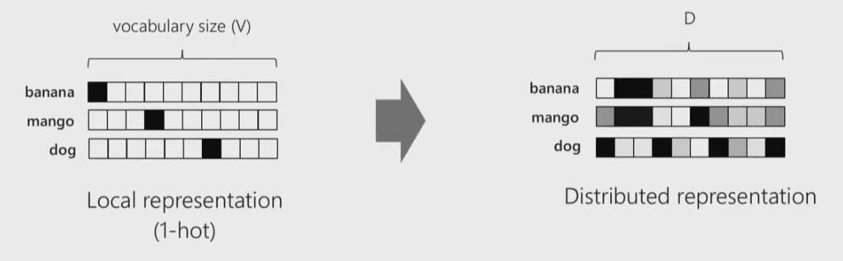
From 1-hot encoding to word embeddings
Note that ‘banana’ and ‘mango’ result with relatively similar vectors (their L2 distance is small, and so is the angle between them).
Image captured from: https://www.youtube.com/watch?v=zCEYiCxrL_0

Slide 5
Very Basic Word Embedding
Every word is represented by an integer (an index).
We will learn a matrix: a row (vector) for every word.
We define weights (and biases) and use a simple softmax regression to go from the embeddings to probabilities that each word would co-occur with other words.
We minimize our mistake.
Our vocabulary has 11 words, and the word embedding will be of length 3.
Distributional similarity based representation (אמור לי מי חבריך ואומר לך מי אתה)

Slide 6
Data
(Royal:) queen king prince princess
(Plain:) woman man girl boy
(Peafowl:) peacock peahen peachick
(Adults:) queen king woman man peacock peahen
(Females:) queen princess woman girl peahen
(Males:) king prince man boy peacock
(Yong:) prince princess girl boy peachick

Slide 7
Data as Expected Prediction
For the correct label (y_) we will use the fraction of times each word co-occurs with each of the other words. E.g.:
0 (queen) [3 2 1 2 2 1 1 0 1 2 0] / 15
Ex. Pred.= [0.2 0.133 0.067 …]
[[ 0.2 0.13333333 0.06666667 0.13333333 0.13333333 0.06666667 0.06666667 0. 0.06666667 0.13333333 0. ]
[ 0.13333333 0.2 0.13333333 0.06666667 0.06666667 0.13333333 0. 0.06666667 0.13333333 0.06666667 0. ]
[ 0.07142857 0.14285714 0.21428571 0.14285714 0. 0.07142857 0.07142857 0.14285714 0.07142857 0. 0.07142857]
[ 0.14285714 0.07142857 0.14285714 0.21428571 0.07142857 0. 0.14285714 0.07142857 0. 0.07142857 0.07142857]
[ 0.13333333 0.06666667 0. 0.06666667 0.2 0.13333333 0.13333333 0.06666667 0.06666667 0.13333333 0. ]
[ 0.06666667 0.13333333 0.06666667 0. 0.13333333 0.2 0.06666667 0.13333333 0.13333333 0.06666667 0. ]
[ 0.07142857 0. 0.07142857 0.14285714 0.14285714 0.07142857 0.21428571 0.14285714 0. 0.07142857 0.07142857]
[ 0. 0.07142857 0.14285714 0.07142857 0.07142857 0.14285714 0.14285714 0.21428571 0.07142857 0. 0.07142857]
[ 0.07142857 0.14285714 0.07142857 0. 0.07142857 0.14285714 0. 0.07142857 0.21428571 0.14285714 0.07142857]
[ 0.14285714 0.07142857 0. 0.07142857 0.14285714 0.07142857 0.07142857 0. 0.14285714 0.21428571 0.07142857]
[ 0. 0. 0.125 0.125 0. 0. 0.125 0.125 0.125 0.125 0.25 ]]

Slide 8
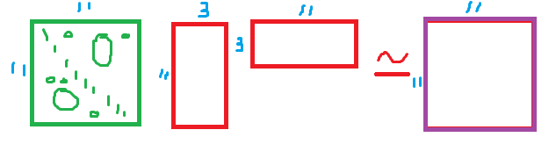
Matrix factorization
We will try finding two matrices that when multiplied, they will give us the frequency matrix.

Slide 9
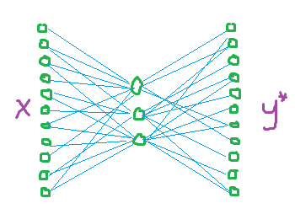
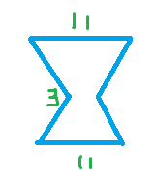
Equivalence to a single hidden layer
This is equivalent to the following fully connected architecture (with no activation), where x is a one-hot encoding of each word, and y is the frequency of that word.

Slide 10
Basic Word Embedding Implementation
Note that each word is associated with two variable vectors.
vocabulary_size = 11
embedding_size = 3
embeddings = tf.Variable(tf.random_uniform([vocabulary_size, embedding_size], -1.0, 1.0)) W1 = tf.Variable(tf.truncated_normal([embedding_size, vocabulary_size], stddev=0.1)) b1 = tf.Variable(tf.zeros([vocabulary_size])) y_ = tf.placeholder(tf.float32, shape=[None, vocabulary_size]) pred = tf.nn.softmax(tf.matmul(embeddings, W1) + b1) cross_entropy = tf.reduce_mean(-tf.reduce_sum(y_ * tf.log(pred), reduction_indices=[1])) update = tf.train.GradientDescentOptimizer(0.5).minimize(cross_entropy)
sess = tf.Session() sess.run(tf.global_variables_initializer()) for i in range(1000): sess.run(update, feed_dict={y_: data_mat})
Note the "soft" labeling
Notes:
(11x3) x (3x11) = (11x11)

Slide 11
Results
[[-0.33625126 -0.74936515 -0.88580781] (queen 0)
[-1.11798966 -0.09931208 0.23002933] (king 1)
[-1.44733107 1.29025459 -0.1947754 ] (prince 2)
[-0.32491446 0.45145106 -1.27872539] (princess 3)
[ 0.27718863 -0.86166698 -0.37928757] (woman 4)
[-0.45815325 -0.31043723 0.77840245] (man 5)
[ 0.64723498 0.32442322 -0.73698401] (girl 6)
[-0.44190836 1.03534842 0.44222212] (boy 7)
[-0.13615488 -0.41988254 1.20282745] (peacock 8)
[ 0.62353653 -0.9595148 -0.08440833] (peahen 9)
[ 1.32446802 1.22546554 0.41412422]] (peachick 10)
>>> embed[0] – embed[4] + embed [7]
array([-1.05534825, 1.14765025, -0.06429812])
>>> embed[0] – embed[1] + embed [7]
array([ 0.33983004, 0.38529535, -0.67361502])
What do you think the second dimension is associated with?
Note that the interpretation is not orthogonal to the dimensions

Slide 12
Where Does the Data Come From?
Our simple word embedding implementation assumed that we had groups of words.
In practice we will rely on a large corpus of documents.
The skip-gram word2vec model tries to predict the frequency of occurrences of the words in the vicinity of a given word.

Slide 13
Skip-Gram Word2Vec
Given a word, guess the surrounding words
The orginal Word2Vec doesn't first count all occurances, but calucates every window seperately.
Instead of actually trying to predict correctly every word, we can add a sample of random noise words and try to predict the correct word from the set.
The loss can be defined in many different ways, in SoftMax we used cross entropy, when we sample negative words we can use sampled softmax and another option is noise-contrastive estimation.
walking
John
was
down
the
Notes:
https://www.youtube.com/watch?v=ERibwqs9p38

Slide 14
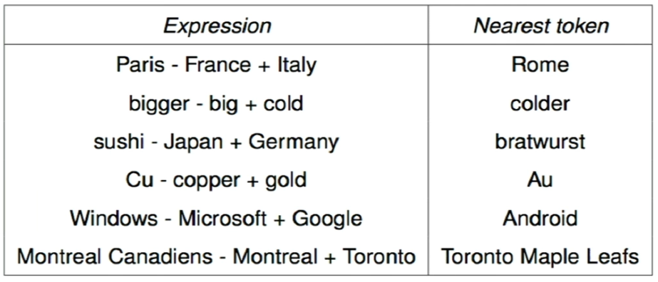
Analogical Reasoning
You can download a dataset from http://download.tensorflow.org/data/questions-words.txt
Source: https://www.youtube.com/watch?v=ASn7ExxLZws

Slide 15
SpaCy
SpaCy is a natural language library in python (similar to NLTK). It has Word2Vec built-in.
>pip install spacy
>python -m spacy.en.download all

Slide 16
SpaCY Word2Vec
import numpy as np from numpy import dot from numpy.linalg import norm from spacy.en import English parser = English() # you can access known words from the parser's vocabulary banana= parser.vocab[u'banana'] # cosine similarity cosine = lambda v1, v2: dot(v1, v2) / (norm(v1) * norm(v2)) # gather all known words, take only the lowercased versions allWords = list({w for w in parser.vocab if not np.any(np.isnan(w.vector)) and norm(w.vector) > 0 and w.lower_ != "banana" and w.is_lower}) # sort by similarity to banana allWords.sort(key=lambda w: cosine(w.vector, banana.vector)) allWords.reverse() print("Top 10 most similar words to banana:") for word in allWords[:10]: print(word.orth_)
Top 10 most similar words to banana:
watermelon
tomato
pineapple
guava
grapefruit
hazelnut
breadfruit
cashew
coconut
turnip
With modification from https://nicschrading.com/project/Intro-to-NLP-with-spaCy/

Slide 17
SpaCY Word2Vec
import numpy as np from numpy import dot from numpy.linalg import norm from spacy.en import English parser = English()
cosine = lambda v1, v2: dot(v1, v2) / (norm(v1) * norm(v2)) king = parser.vocab[u'king'] man = parser.vocab[u'man'] woman = parser.vocab[u'woman'] result = king.vector - man.vector + woman.vector # gather all known words, take only the lowercased versions allWords = list({w for w in parser.vocab if not np.any(np.isnan(w.vector)) and norm(w.vector) > 0 and w.orth_.islower() and w.lower_ != "king" and w.lower_ != "man" and w.lower_ != "woman"}) # sort by similarity to the result allWords.sort(key=lambda w: cosine(w.vector, result)) allWords.reverse() print("Top 3 closest results for king - man + woman:") for word in allWords[:3]: print(word.orth_)
Top 3 closest results for king - man + woman:
queen
monarch
princess
With modification from https://nicschrading.com/project/Intro-to-NLP-with-spaCy/

Slide 18
Document / Paragraph / Sentence 2 Vec (skip thoughts vector)
Many times we want to measure the similarity between documents using word 2 vec.
A naïve implementation would sum the vectors of all words in sentence / document and then measure similarity (cosine).
But Word2Vec may be problematic for words which have more than one meaning e.g. "Apple", "right", "leaves" (polysemy). We also have the bag-of-words model problem.

Slide 19
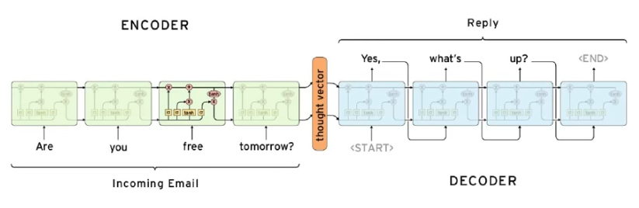
Sentence 2 Vec From Translation

Slide 20
SVD Based Word Embedding
Start with a co-occurance matrix (with some defined window), no need to rescale.
Define required vector size.
Solve SVD (Singular Value Decomposition). (A method used also for matrix inversion for non squared matrix.)

Slide 21
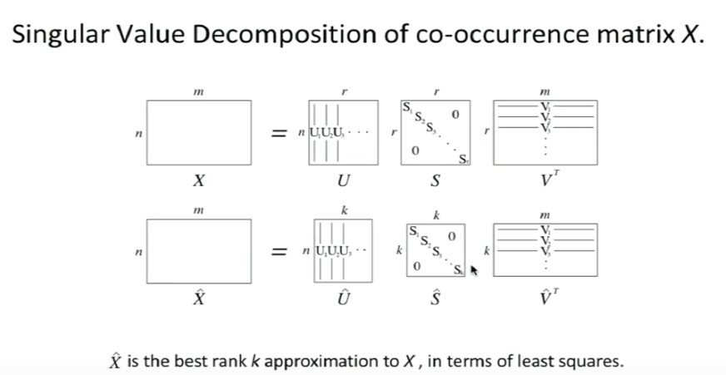
Source: https://www.youtube.com/watch?v=ASn7ExxLZws

Slide 22
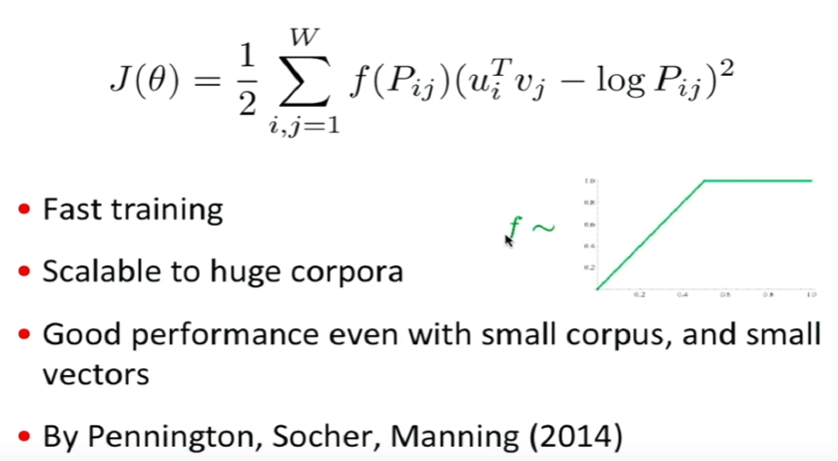
GloVe: Global Vectors for Word Representation
Start with a co-occurance matrix (with some defined window), no need to rescale.
Source: https://www.youtube.com/watch?v=ASn7ExxLZws

Slide 23
GloVe
The final embeddings are the sum U + V.
300 dimension vectors worked best.
Window size of 8 was best.

